Slide 1

Tampa Trends in Real Estate Investment
Carla Bertoli,
Viviana Garcia,
Gloria Gonzalez,
Erich McCartney
ISM6562
Big Data for Business

Slide 2


Fast Facts from the Tampa Bay Economic Development Council
© McNichols
The Tampa Metropolitan Area has more than 3.1 million residents
Population growth is expected to be 25% over the next 20 years
Tampa Bay's high growth industries include financial and professional services, as well as information technology, manufacturing, and distribution and logistics
The typical value of a home in Tampa is $270,958 as of October 2020
The most expensive neighborhood in Tampa is Sunset Park and the most affordable neighborhood is East Tampa
The Kiplinger publication reports that Tampa Bay home prices have increased by 94% since the last cycle market bottom in 2012.

Slide 3
Real Estate in Hillsborough County
Scope: retrieved data from the Hillsborough County Property Appraisals
40% of the data was updated to accurately account for current home prices.
Sale Home Prices and Taxes are updated and accurately accounted.
MLS and Zillow are the best sources for real estate information as Zillow pulls its information from MLS. ( MLS is a REALTOR RESOURCE ONLY ACCESS)
School districts drive home prices and a more established school; the more home prices will rise.
School ratings are done by testing and programs provide; these ratings are updated every 6 months
New Construction of Schools may also provide growth in specific neighborhoods

Slide 4
Predicting Real Estate in Hillsborough County
Attributes that may present a strong impact:
Top Schools (HIGH RANKED)
Closeness to Restaurants and Entertainment
Lot size
Following Questions our Team aspires to understand:
Can analytics offer important insights on current Tampa trends?
Does location, school ratings, and life quality rates affect pricing?
What other attributes might determine the accurate value of properties.
We encouraged ourselves to find a variation when selecting data and knowledge that there would be specific variable(s) that may allow people to stay and thrive in their communities.

Slide 5
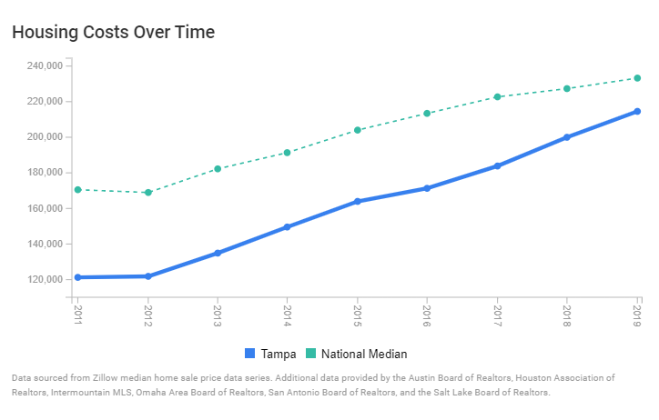
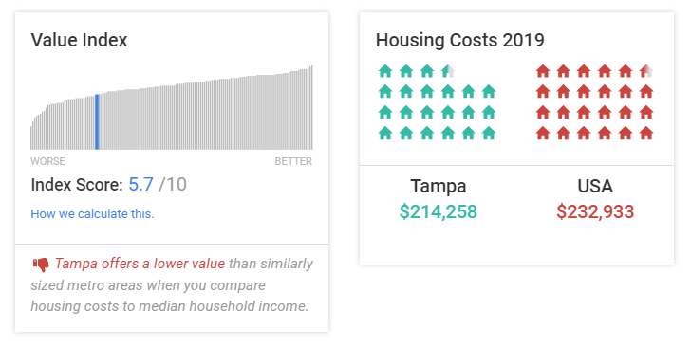
Data Source and Preparation

Slide 6
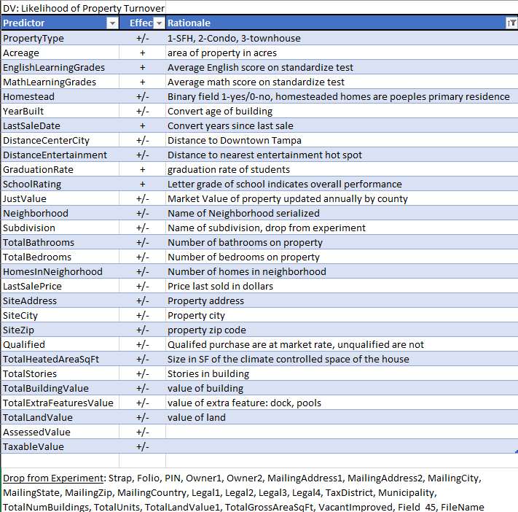
Target(s) and Attribute(s)

Slide 7
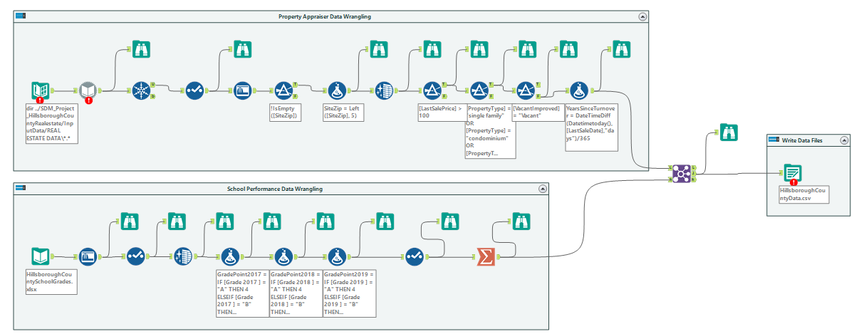
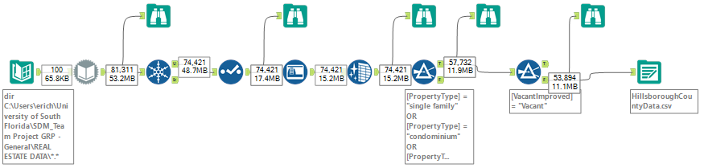
Data Sources & Collection
Home Appraiser Data (Updated Monthly): https://www.hcpafl.org/
Florida School Accountability Reports (Updated Semi-Annually): http://www.fldoe.org/accountability/accountability-reporting/school-grades/
Collected in multiple files, consolidated and cleaned in Alteryx

Slide 8
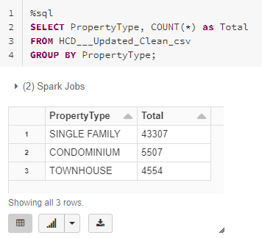
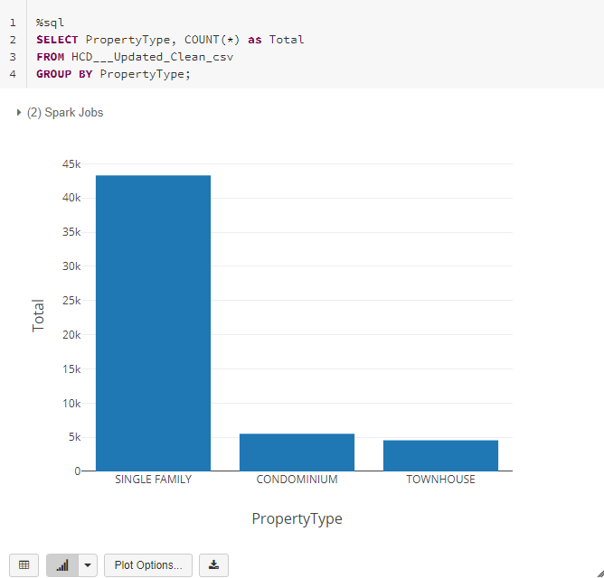
Data Analysis and Visualization in Databricks

Slide 9
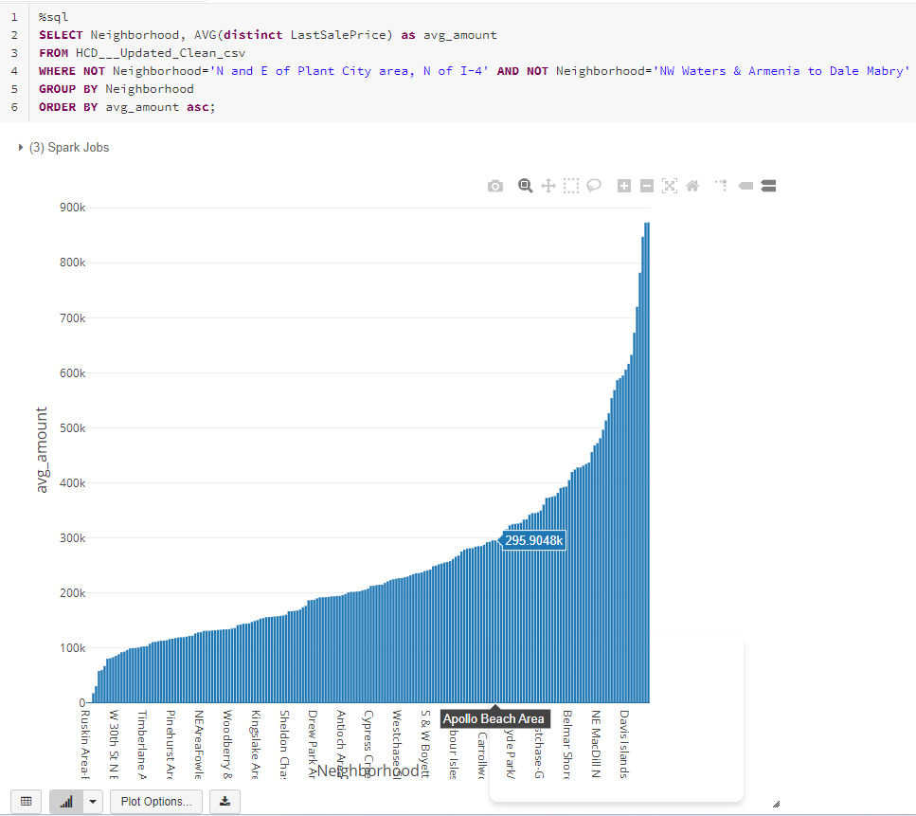
Data Analysis and Visualization in Databricks
Notes:
In the following example, we have added some complexity to our queries. In this example, we want to know the average home selling price for each neighborhood in our data, and we want to see it from lowest to greatest. As shown in the figure, Databricks visualization feature allows for interactivity which allowed us to toggle between data points in the graph.

Slide 10
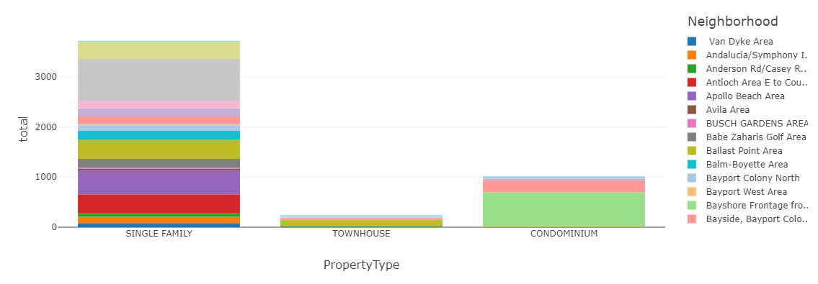
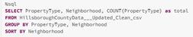
Data Analysis and Visualization with Databricks
Home Appraiser Data (Updated Monthly): https://www.hcpafl.org/
Collected in multiple files, consolidated and cleaned in Alteryx
Analyzed Property Type by Neighborhood

Slide 11
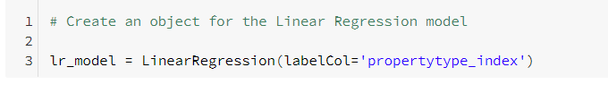
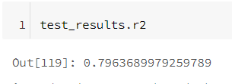
Data Analysis with Linear Regression
Home Appraiser Data (Updated Monthly): https://www.hcpafl.org/
Collected in multiple files, consolidated and cleaned in Alteryx
Analyzed the Property Type effect on Assessed Value
Model Accuracy 80%

Slide 12
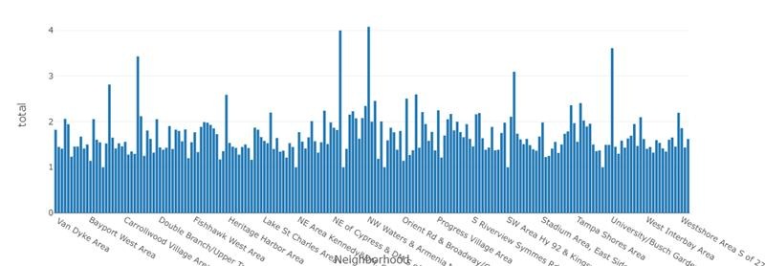
Data Analysis with ….
Home Appraiser Data (Updated Monthly): https://www.hcpafl.org/
Florida School Accountability Reports (Updated Semi-Annually): http://www.fldoe.org/accountability/accountability-reporting/school-grades/
Collected in multiple files, consolidated and cleaned in Alteryx

Slide 13
Data Analysis with ….
Home Appraiser Data (Updated Monthly): https://www.hcpafl.org/
Florida School Accountability Reports (Updated Semi-Annually): http://www.fldoe.org/accountability/accountability-reporting/school-grades/
Collected in multiple files, consolidated and cleaned in Alteryx

Slide 14
Data Analysis with ….
Home Appraiser Data (Updated Monthly): https://www.hcpafl.org/
Florida School Accountability Reports (Updated Semi-Annually): http://www.fldoe.org/accountability/accountability-reporting/school-grades/
Collected in multiple files, consolidated and cleaned in Alteryx

Slide 15





Tools Used

Slide 16
Data Conclusion from Machine Learning
In conclusion, the relationships identified were between more bathrooms and the size of the dwelling relative to the lot size.
There is a 2.5% more chance of turnover in dwellings with less or one bathroom, compared to the lot size, and the relationship between the dwelling size represented a 3% more likely for a property to turnover.
With larger homes with more bathrooms on larger lots, indicate that more expensive properties are turning over faster than lower-priced modest homes.
Finally, the data also gave us nine neighborhoods that experienced the least turnover, meaning that current owners are likely to possess more equity in the properties to be targeted for listing opportunities.

